Slide 1


Slide 2
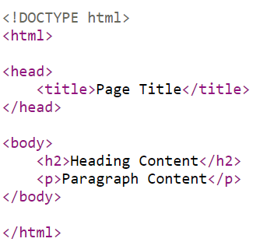
Basic Structure of HTML

Slide 3
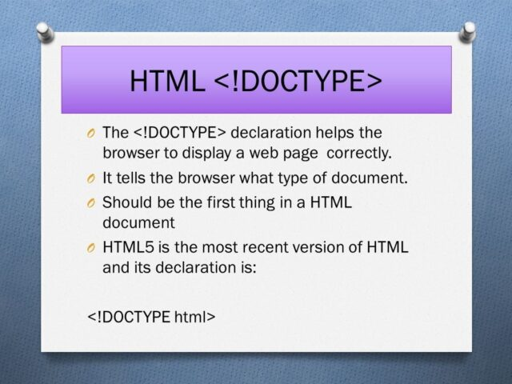

Slide 4
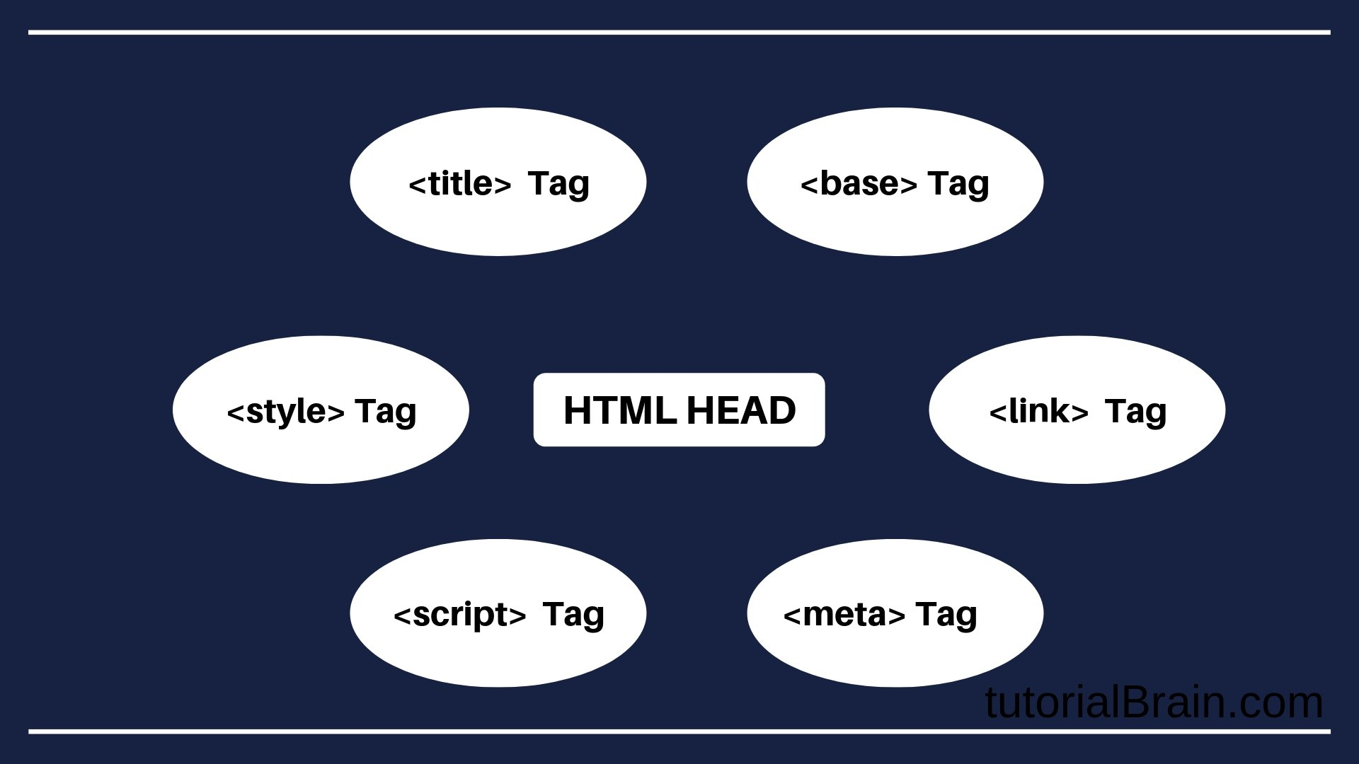

Slide 5
HTML Elements
The HTML element is everything from the start tag to the end tag:
<tagname>Content goes here...</tagname>
Examples of some HTML elements:
<h1>My First Heading</h1>
<p>My first paragraph.</p>

Slide 6
